Slide 1
My Career
Salim El Rouayheb
ECE Department
Rutgers University

Slide 2
Message of Hope
Third time a charm
First try in Summer 2014
  Title: A Fundamental Theory of Index Coding: Looking Beyond Worst Cases
  Low Competitive
Second try in summer 2015
  Title: : Security and Privacy in Distributed Storage Systems: An Information Theoretic Approach
  Competitive
Third try in summer 2016
  Title: Information Theoretic Methods for Private Information Retrieval and Search in Distributed Storage Systems
  High Competitive (CIF panel)
  Competitive (SaTSE panel)

Slide 3
What Helped Me
Sitting on NSF Panel
Topic & First Pages
Feedback
Other

Slide 4
What Helped Me the MOST
1. Sitting on an NSF Panel
Personal opinion: It is worth delaying CAREER until you sit on a panel
But does it help since you won’t sit on a CAREER panel?
What did I learn there? Next.
But main thing I was getting too technical too quickly without covering my basis. Play defense.

Slide 5



2. Choice of Topic
“Transformativeness”
& Novelty
& Urgency
& Ambition
Curing Cancer
Operate Here
CAREER ’15
Privacy
CAREER ’16
Privacy
CAREER ’15
Security
CAREER ’14
Index Coding
PhD thesis
Credentials & Qualifications
“Some of the proposed problems, e.g. some of the security aspects, were regarded as incremental…. Privacy is a relatively new area for information theorists and the panel encourages this direction of research.”

Slide 6
2.Choice of Topic
I tried to get feedback on the topic early on even before having draft
  Senior Colleagues
  Program director,…
I tried to give talks on my CAREER topic at major conferences hoping to impress possible panelists in the audience
I found feedback from previous year panel helpful in narrowing down my topic
“Transformativeness”
Operate Here

Slide 7
3.Polishing First Pages:
The Three Wishes
First few pages are prime time. Should make reviewer excited & jealous
“I wish I was working on this area”
  After reading first paragraph/page
“If I were working in that area, I wish I was working on this problem”
  After reading 2nd paragraph/page
“I wish I was him/her”
  After reading 3rd paragraph/page
  (unknown via Pulkit Grover)

Slide 8
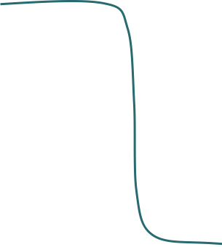
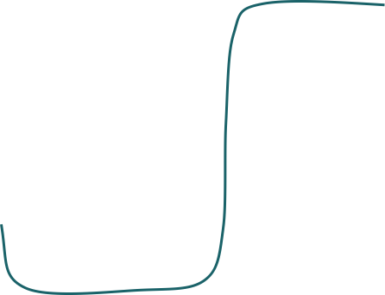
3. Polishing First Few Pages
Importance
Model and Motivation
Technical
Educational
broader impacts &
Intellectual Merits
Page Number

Slide 9
Polishing First Few Pages
Motivation Million dollar question, Urgency, etc.
Transformativeness & Novelty
  Didn’t X,Y,Z work on this problem? What’s the novelty here?
  Sounds (even vaguely) like related problem in different field. How is it different? Citations…
  Do not dis the other field(s). The different approaches are complementary…
Model
  Reviewers may have biases against certain areas/models
  Acknowledge weakness right away and justify assumptions
  “Shoot yourself in the leg and make them pity you better then getting killed” Kannan Ramchandran
Overview of research & Education plan:
“The key references were not cited. There is a lot of work at the intersection of coding and optimization that was not mentioned.”
“There was concern about the fragility of the security and privacy models and that some of the privacy problems were too restricted in their scope.”

Slide 10
Polishing Last Few Pages
Intellectual Merit
Broader Impacts
Educational Plan
  I thought my best bet is to include outreach activities that I’m passionate about and would enjoy doing
  Popular science videos Youtube addressed to general public
  Shannon Channel online talk series
“While the panel would like to commend the PI on his educational and outreach plan, they would like to point out that none of these activities have yet started and that it is not clear whether the PI will be able to carry them all out. ”
“In the broader impacts, the motivation in cryptography and practical application could have been significantly strengthened by providing more detail on use case, and justifying specific claims […] on what the current problematic bottlenecks in systems are. “

Slide 11
Feedback
I tried to get as much feedback as I can
  On choice of topic, general advice, draft
  From recent awardee, “medium senior” and senior researchers in my field
  From friends in academia in other fields
  From Program directors
  Kept in mind: people are biased either for you and for the field or have reservation against the field… Keep true to yourself and your vision
Some of the helpful general advice I got
  “Don’t make your CAREER a laundry list of things to do” Emina Soljanin via Olgica Milenkovic
  “Think you are writing a proposal to impress the senior member of your community.” Alex Dimakis
  “The reviewer should get what your proposal is about by just reading your section titles.” Natasha Devroye

Slide 12
The End: Our Lab
Coding & Security Information (CSI) Lab

Slide 13

Good Luck
Notes:
13

