Slide 1
Secret Sharing in Distributed Storage Systems
Salim El Rouayheb
Illinois Institute of Technology
Nexus of Information and Computation Theories
Paris, Feb 2016

Slide 2
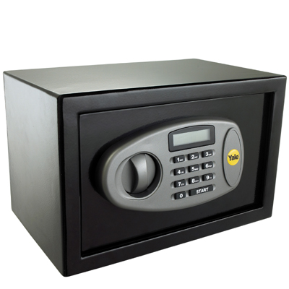










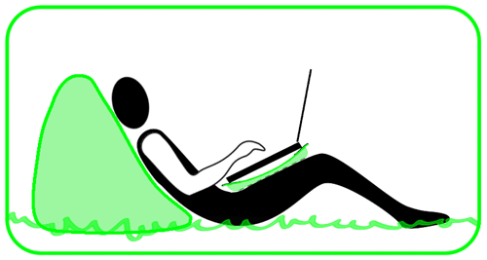
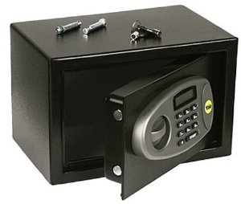
“How to Share a Secret?”
Secret
(n,k)=(4,2) threshold secret sharing [Shamir ‘79]
n=4: number of parties
k=2: threshold
l colluding parties
Share size=1 unit
Max secret size=k-l
Dealer
S
K: random symbol independent of S
K
S+K
S+2K
S+3K
Party 1
Party 2
Party 3
Party 4
secret
K
S+3K
random
keys
S
User
User needs 2 shares to decode the secret
Vandermonde

Slide 3


How to Store a Secret? and never lose it or reveal it
Dealer
Shares stored in a distributed system
“Failures are the norm rather than the exception” Google
Secret
Safe
K
S+K
S+2K
S+3K
Party 1
Party 2
Party 3
Party 4
S+K
S+2K
Party 1’
Secret leaked!
K
Notes:
Can you add a disk picture near or under each party… I tried to do 1 but I don’t know where to put it. I wanna say that now the shares are stored on disks

Slide 4
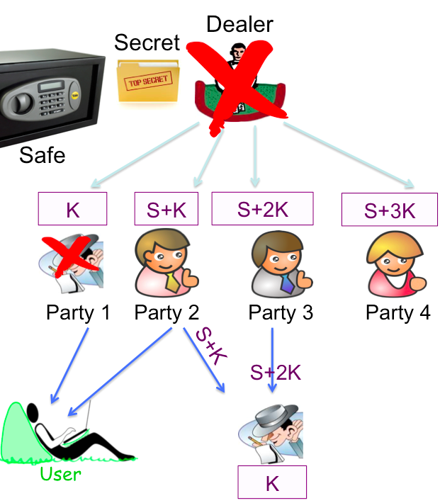
Plan for this Talk
How to “repair” a secret?
2 takeaways
2) How to deliver a secret?
1 takeaway

Slide 5
i.
How to repair a secret?

Slide 6

Repairing a secret using secure regenerating codes
Dealer
Idea: minimize info observed by party 1’
Use “best” regenerating codes that minimize repair bandwidth [Dimakis et al. ‘10]
Secret
S
s+k₁
k₁+k₂
k₂+k₃
k₃+k₁
s+k₁+k₂+k₃
2k₁+k₂+k₃
k₁+2k₂+k₃
s+2k₃
Here, repair bw≥1.5 (info theoretic bound)
Secret size= k-repair bw=0.5
Party 1
Party 2
Party 3
Party 4
k₂+k₃
0.5
k₁+2k₂+k₃
0.5
s+k₁+k₂+k₃
0.5
Party 1’
s+k₂
k₁+k₂
Notes:
Can you start by having all the squares empty with question marks (same bakground color you can use same squares on top of the these squares)
When I click the last two points appear and a number .5 appear next to each donwload link
another clcik the code appear. But, let’s make the packets downloaded by party 1’ the first packet in each square (easierfor the audience to spot also make it blue)

Slide 7

Separation Scheme
Q: Does this separation based scheme max secret size under repair dynamics?
A: No! Separation is not optimal.
# 1
secret
Maximum Rank Distance code
Preprocessing for security
keys
Regenerating code instead of Reed-Solomon code to minimize repair bandwidth
Minimum Storage Regenerating code
shares

Slide 8
A Scheme Better than Separation
We can store a secret of size 2/3 >1/2
each share 1/3 unit
k₁, k₂, k₃
(6,5) classical secret sharing, l=3
1
2
3
4
5
6
s₁, s₂
failure
Secret not leaked
1
2
3
1
1
2
3
1
4
5
2
2
4
6
3
3
5
6
Secret size=
H(k shares) – H(downloaded data during repair)
(n,k)= (4,2) secret sharing
[Rashmi, Shah, Kumar, Ramchandran ‘09]
[Pawar, R, Ramchandran ‘11]
Notes:
Make the first click appear w/o a click
Fix animation

Slide 9


General Problem Formulation
What is the maximum secret size C^{s}, called secrecy capacity that we can store and repair in a distributed storage system?
No Dealer
n: total number of parties/nodes
k: threshold to decode secret
l: colluding shares
d: helpers during repair
...
1
2
3
4
5
6
…
n
k
d
k
1’
d
User

Slide 10
Secrecy Capacity
Hard problem. Still Open in general. (more later)
Maybe the problem becomes more tractable if we add constraints on the repair bw= β on each link
Theorem: [Pawar, R., Ramchandran ‘11] The secrecy capacity of a decentralized (n,k) secret sharing with repair degree d and l colluding parties is upper bounded by
Where, β is the amount of data sent by a party during the repair of a failed party.
failure
Party 1
1
2
3
1
β =1/3 secret size
Previous scheme achieves secrecy capacity
β
1
2
3
Party 2
1
4
5
2
β
Party 3
2
4
6
3
β
Party 4
3
5
6
(n,k)= (4,2) secret sharing
Notes:
Animate in order from top to bottom.
2 clicks

Slide 11
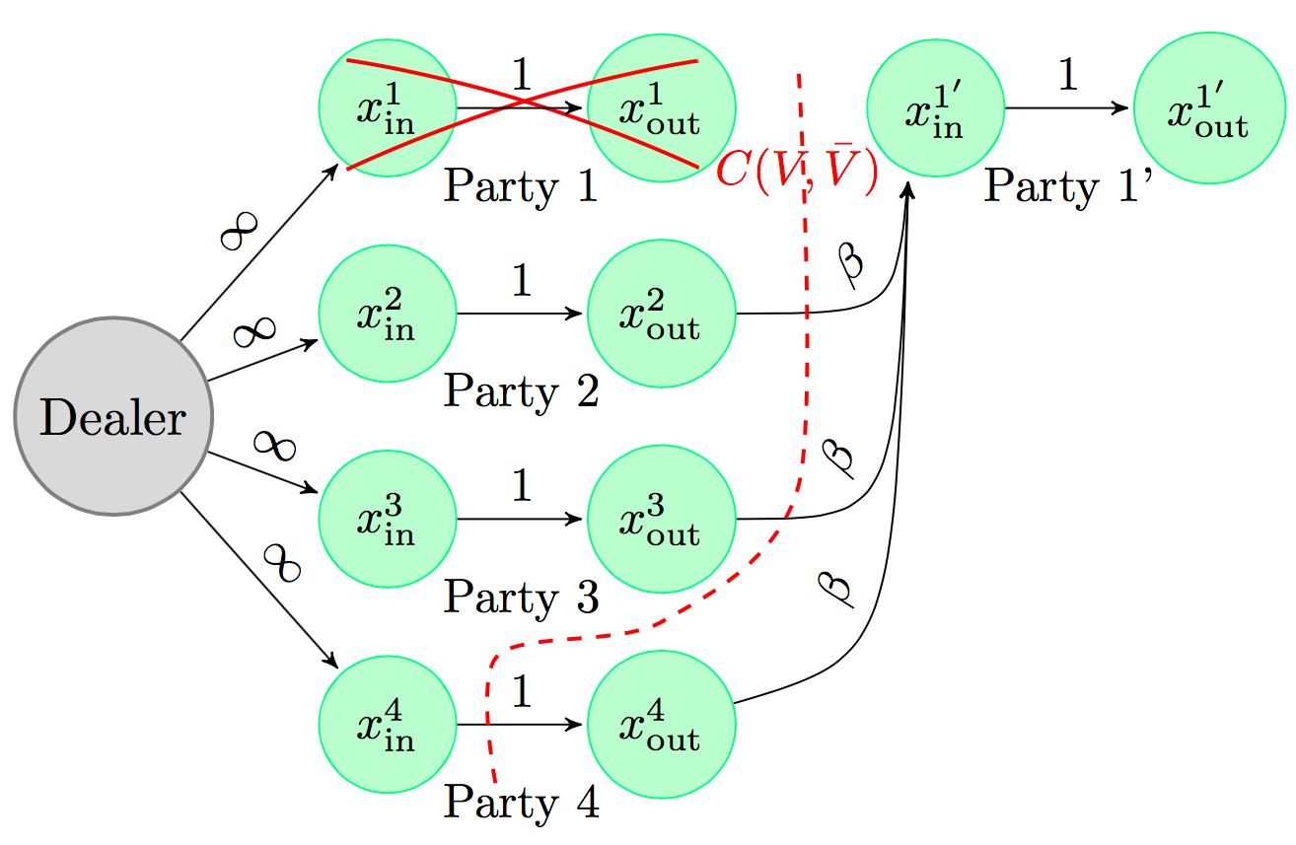
Proof Ingredients
Functional instead of exact repair
Flowgraph representation (Multicast)
Securing minimum cuts
User 1
User 2
User 4
User 3
Notes:
Add the cut in red and next to it in the figure the value of the cut

Slide 12
Achievability
For d=n-1:
k₁, k₂, …, k_{R}
(θ,M) classical secret sharing, l=R
1
2
3
4
5
θ
…
s₁, s₂, .. , s_{M-R}
Theorem: [Pawar, R., Ramchandran ‘10] Suppose β≤1/d, the secrecy capacity of a decentralized (n,k) secret sharing with repair degree d and l colluding parties is given by
Party 1
1
2
…
d
Party 2
1
d+1
…
M-1
For any d, secure MBR Product-Matrix can be used [Rashmi, Shah Kumar ‘11]
Party 3
2
d+1
…
M-3
…
…
…
…
Party n
d
M-1
…
θ
Notes:
Theorem on top then scheme
I’m not sure the year of my paper with pawar is same as rashmi bc we came first. Maybe refer to Isit paper
Do we have a slide on an example on secrecy with product matrix that you insert right after that. I will skip it but just to give them an idea…

Slide 13
Product-Matrix Codes
Example: (5,2,3), α=3 and Field size q=7
.
Ψ= | 1 | 1 | 1
 | 1 | 2 | 4
 | 1 | 3 | 2
 | 1 | 4 | 2
 | 1 | 5 | 4
M= | k₁ | k₂ | k₃
 | k₂ | s₁ | s₂
 | k₄ | s₂ | 0
1
k₁+k₂+k₃ k₂+s₁+u₂ k₃+s₂
.
2
k₁+2k₂+4k₃ k₂+2s₁+4s₂ k₃+2s₂
3
k₁+3k₂+2k₃ k₂+3s₁+2s₂ k₃+3s₂
Message matrix
4
k₁+4k₂+2k₃ k₂+4s₁+2s₂ k₃+4s₂
.
Vandermonde matrix
5
k₁+5k₂+4k₃ k₂+5s₁+4s₂ k₃+5s₂
Storage System
-1
3’
General form of message matrix
Remark: File reconstruction follows from the use of Vandermonde matrix
[K. V. Rashmi, N. B. Shah and P. V. Kumar, ‘11]

Slide 14
Back to the Original Problem with no BW Constraints
Theorem: [Tandon et al. ’14] The previous schemes achieve capacity in the non-bw constrained regime in the following cases:
1) (n,n-1) perfect (i.e. l=n-2) secret sharing, with d=n-1, by
2) (n,2) perfect (l=1) secret sharing and any repair degree d,
failure
Party 1
1
2
3
1
β =1/3 secret size
Previous scheme achieves secrecy capacity
β
1
2
3
Party 2
1
4
5
2
β
Party 3
2
4
6
3
β
Party 4
3
5
6
(n,k)= (4,2) secret sharing
Notes:
Use picture on bottom of slide 9 here

Slide 15
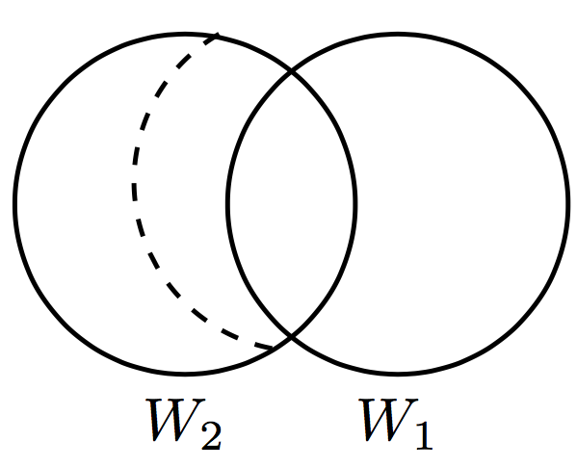
Beyond Bandwidth Limited regime (cont’d)
Party 1
Party 2
Party 3
Party 4
We want to show that for any β:
W₁
W₂
W₃
W₄
D₂₁
D₃₁
D₄₁
D₁=(D₂₁,D₃₁,D₄₁)
(n,k)=(4,2) secret sharing l=1
W₁
Party 1’
Secrecy:
Similarly
Notes:
Remove animation

Slide 16


Open Problems
(n,k) secret sharing | k=2 | k=3 | k=4 | … | k=n-2 | k=n-1
Perfect secret sharing (l=k-1)
Imperfect secret sharing (l<k-1)
Table 1: Summary of results
Characterization of the secrecy capacity for any (n,k) secret sharing with any d and l.
Security in the case of functional repair?
What if the parties are malicious? [Bitar, ER ‘15] [Pawar, ER, Ramchandran ‘11]
MDS codes are everywhere. What is the maximum secret size that they can achieve?
Notes:
Instead of the X in the table make it a dark grey square

Slide 17
How to repair MDS (Shamir’s) Scheme?
...
(n,k) MDS
code
l colluding parties
repair degree d
1
2
3
4
5
6
…
n
k
d
1’
User
Theorem: [Goparaju, R., Calderbank, Poor Netcod ’13]
The linear secure capacity of an (n,k) storage system with exact repair is
where l is the nbr of eavesdropping parties
Achievable for d=n-1 (contact all available nodes when repairing)
Notes:
add references to theorem

Slide 18
Information Leakage
Theorem: [Goparaju, R., Calderbank, Poor Netcod ’13]
The linear secure capacity of an (n,k=n-2) storage system with exact repair is
.
.
.
Max secret size decreases exponentially with l.
# 2
Notes:
Alpha/2(1+1/2+…+1/2^{b-1})=alpha/2(1-(1/2)^{b}/1/2))=alpha/2(2-1/2^b)=alpha-alpha/2^b+1

Slide 19
The Linear case
(n,k)=(5,3)
l=2 colluding parties
S₁
Data observed by the l parties =
Data stored on parties 1’ and 5’
+
Data downloaded from party 2
1’
S₂
5’
Theorem: [Goparaju, R., Calderbank, Poor Netcod ’13]
Notes:
Alpha/2(1+1/2+…+1/2^{b-1})=alpha/2(1-(1/2)^{b}/1/2))=alpha/2(2-1/2^b)=alpha-alpha/2^b+1

Slide 20
A Taste of the Proof…
??
S₂
S₃
Party 1’ downloads:
1’
S_{k+1}
S_{k+2}
Analogy to interference alignment
Write these subspace conditions for all failures
Use them to proof theorem by induction
Notes:
I could not get the intuition of the proof. But, I think as you wrote in the slide if we write the equations for all failures we can check how the intersection is happening.
Also here there is alpha, you might want to say that alpha is the subpacketization or something
f_1=\left[\begin{array}{c}f_{11}\\\vdots\\f_{1\alpha}\\\end{array}\right]

Slide 21




Secure Code Construction
Maximum rank distance
Zigzag
codes
MRD
Zigzag
Codes
file
[Tamo et al.’11 ]
[Silberstein et al.’12 ]
Storage system
Keys
Open problems:
Upper bound achievable if all nodes can be wiretapped?
Do functional repair and/or non-linear coding increase secure capacity?
What about d<n-1?
Notes:
Remove animation
f_1=\left[\begin{array}{c}f_{11}\\\vdots\\f_{1\alpha}\\\end{array}\right]

Slide 22
ii.
How to deliver a secret?

Slide 23
What is the communication cost of delivering the secret to a user?
User 1 downloads 2 units
Can decode the secret and the key
But, doesn’t want the key
s₁+s₂+k₁
s₁₊2s₂+k₂
1
S+K
S
User 1
s₁,s₂
k
k₁,k₂
2
s₁+k₁
s₂+k₂
S+2K
s₁+k₁
3
s₂+k₁
s₁+k₂
S+3K
s₂+k₁
S
s₁,s₂
k₁
k₂
k₁
s₁,s₂
4
K
User 2
k₁
d=3
(n,k)=(4,2) secret sharing with l=1 colluding parties
User 2 contacts 3 shares and downloads 3/2 units
Comm. cost can be decreased bc user does not need to decode the keys.
# 3

Slide 24
How to Deliver a Secret?
s₁+s₂+k₁
s₁₊2s₂+k₂
Theorem: [Huang, Langberg, Kliewer, Bruck ’15]
1
s₁,s₂
User 1
s₁+k₁
s₂+k₂
k₁,k₂
2
s₂+k₁
s₁+k₂
s₁+k₁
3
s₂+k₁
s₁,s₂
k₁
k₂
k₁
s₁,s₂
4
User 2
d=3
k₁
Characterization of the minimum communication cost (CC(d)) for a given d
Achievability of the bound for d=n via deterministic, Reed-Solomon based, codes
Achievability of the bound simultaneously for all d, k≤d≤n, via random codes

Slide 25
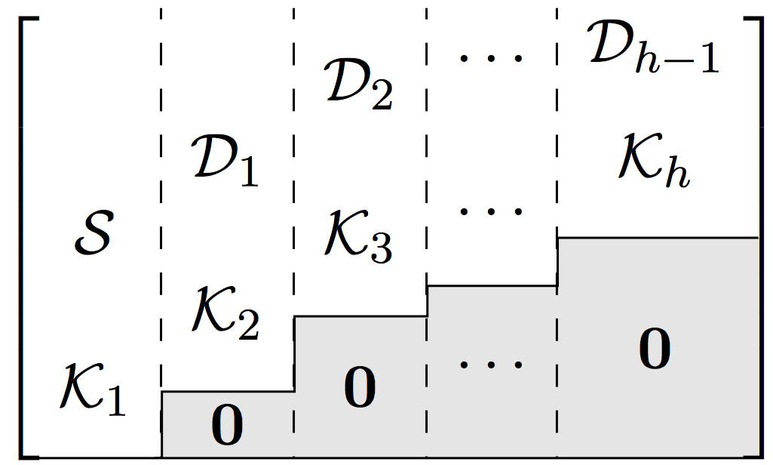
Staircase codes
Theorem: [Bitar, El Rouayheb ISIT’16] There exists an (n,k,d) staircase code constructed in GF(q), q≥n, and that achieves minimum communication cost for k≤d≤n and any l<k.
Theorem: [Bitar, El Rouayheb ISIT’16] The (n,k) universal staircase code constructed as follows in GF(q), q≥n, achieves minimum communication cost for any d, such that k≤d≤n.
Vandermonde
Notes:
looks like a row vector. Make the vandermond matrix a matrix
share $n$

Slide 26
(4,2) Universal Staircase Codes
s₁, s₂, s₃, s₄, s₄, s₆
Encoding
Party 1
Party 2
Party 3
Party 4
s₁+s₂+s₃+k₁
s₁+2s₂+4s₃+3k₁
s₁+3s₂+4s₃+2k₁
s₁+4s₂+s₃+4k₁
User
s₁, s₂, s₃, s₄, s₄, s₆
s₃, s₆, k₃, k₄, k₅, k₆
s₄+s₅+s₆+k₂
s₄+2s₅+4s₆+3k₂
s₄+3s₅+4s₆+2k₂
s₄+4s₅+s₆+4k₂
k₁+k₂+k₃
k₁+2k₂+4k₃
k₁+3k₂+4k₃
k₁+4k₂+k₃
k₁, k₂
k₁, k₂, k₃
s₃+k₄
s₃+2k₄
s₃+3k₄
s₃+4k₄
s₁, s₂, s₄, s₅
s₆+k₅
s₆+2k₅
s₆+3k₅
s₆+4k₅
k₃+k₆
k₃+2k₆
k₃+3k₆
k₃+4k₆
User downloads:
12 packets,
9 packets,
8 packets.
Notes:
I can make the user decode s1 s2 first but it will take much time. The present color coding should make it easier.

Slide 27
Open problems
Is there a Communication Efficient Secret Sharing schemes with general access structure, i.e., beyond threshold secret sharing?
What if the dealer does not have direct access to the parties, but can reach them through a network?
What if the shares are controlled by a malicious adversary?
Repairable secret shares with min communication cost?

Slide 28

QUESTIONS?
Notes:
28

